Slide 1
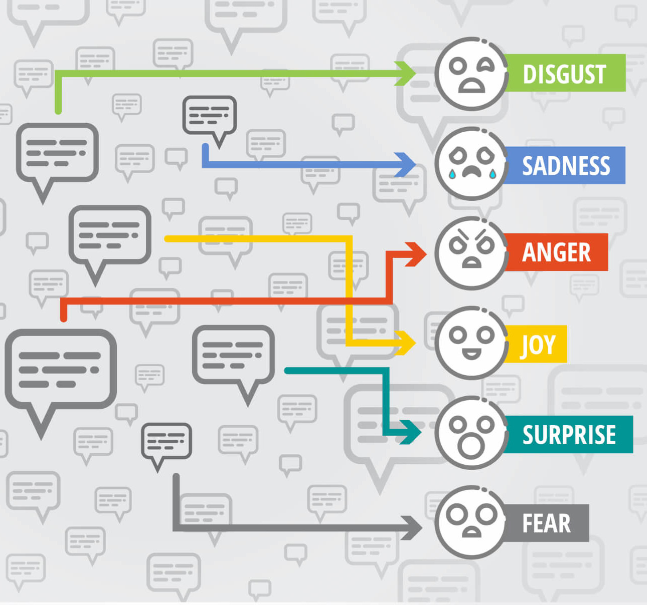
SENTIMENT ANALYSIS
TEAM-ARES
BHAVADHARINIE S – 18Z213
GAYATHRI B – 18Z18
KRIPAA HARIKUMAR – 18Z227

Slide 2

PROBLEM STATEMENT
To build a Sentiment Analyzer by Sentiment analysis which is a process of computationally identifying and categorizing opinions from a piece of text and check whether the writer's attitude towards a particular topic is positive, negative or neutral.

Slide 3

TWITTER SENTIMENT ANALYSIS
We have used twitter to analyze sentiment because thousands of people keep posting their reactions and opinions on millions of topics. It acts as a huge database of opinions that keeps updating every second .
Using sentiment analysis, unstructured data could be automatically transformed into structured data of public opinions.

Slide 4



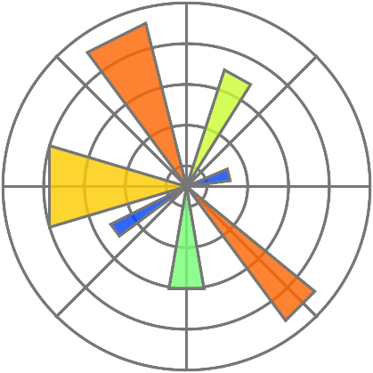

PACKAGES / LIBRARIES USED:
TEXTBLOB
TWEEPY
MATPLOTLIB
TIME
JSON
RE
SYS

Slide 5
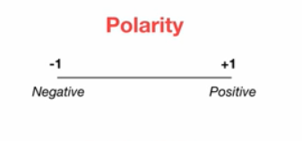
INPUT: Keyword/Hashtag to be found.
OUTPUT: The live tweets(200 tweets) and the Sentiment score* for each tweet is specified along with an interactive plot.
Sentiment score* in terms of polarity

Slide 6
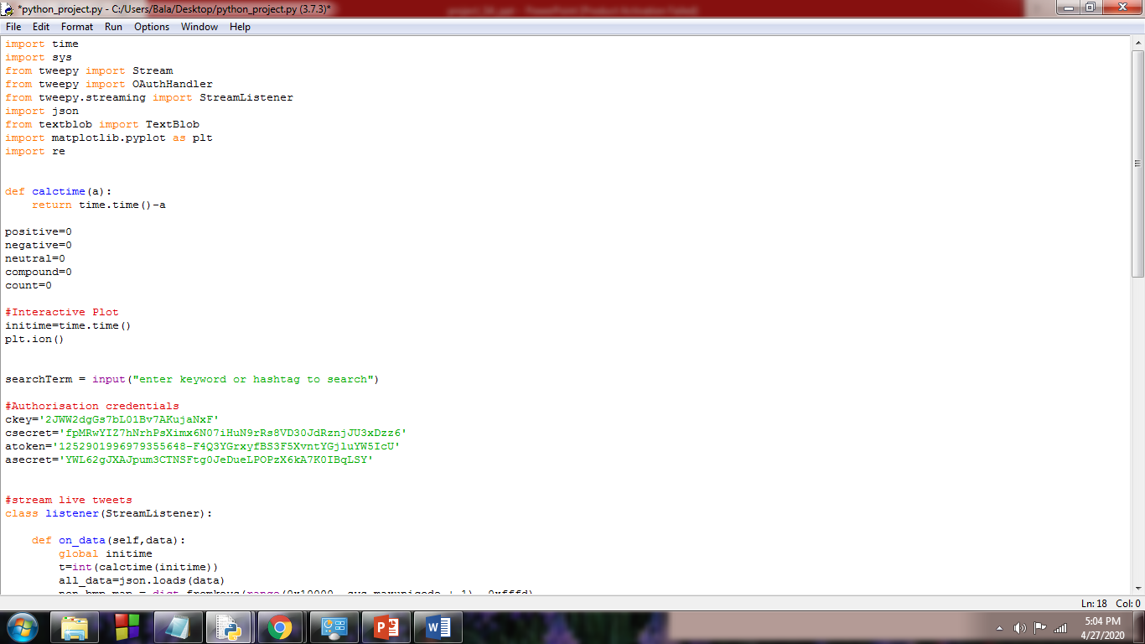
CODE

Slide 7
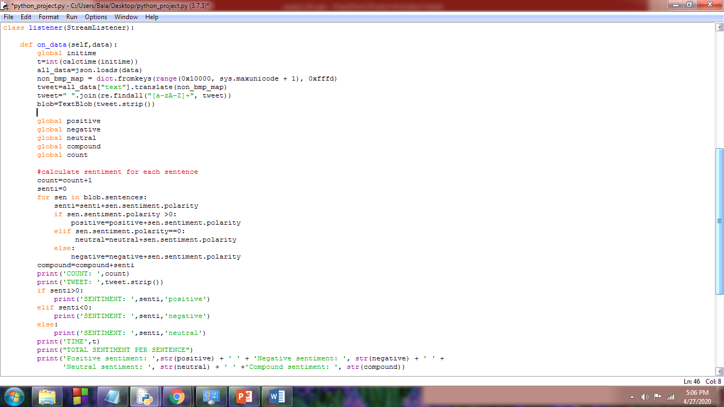

Slide 8
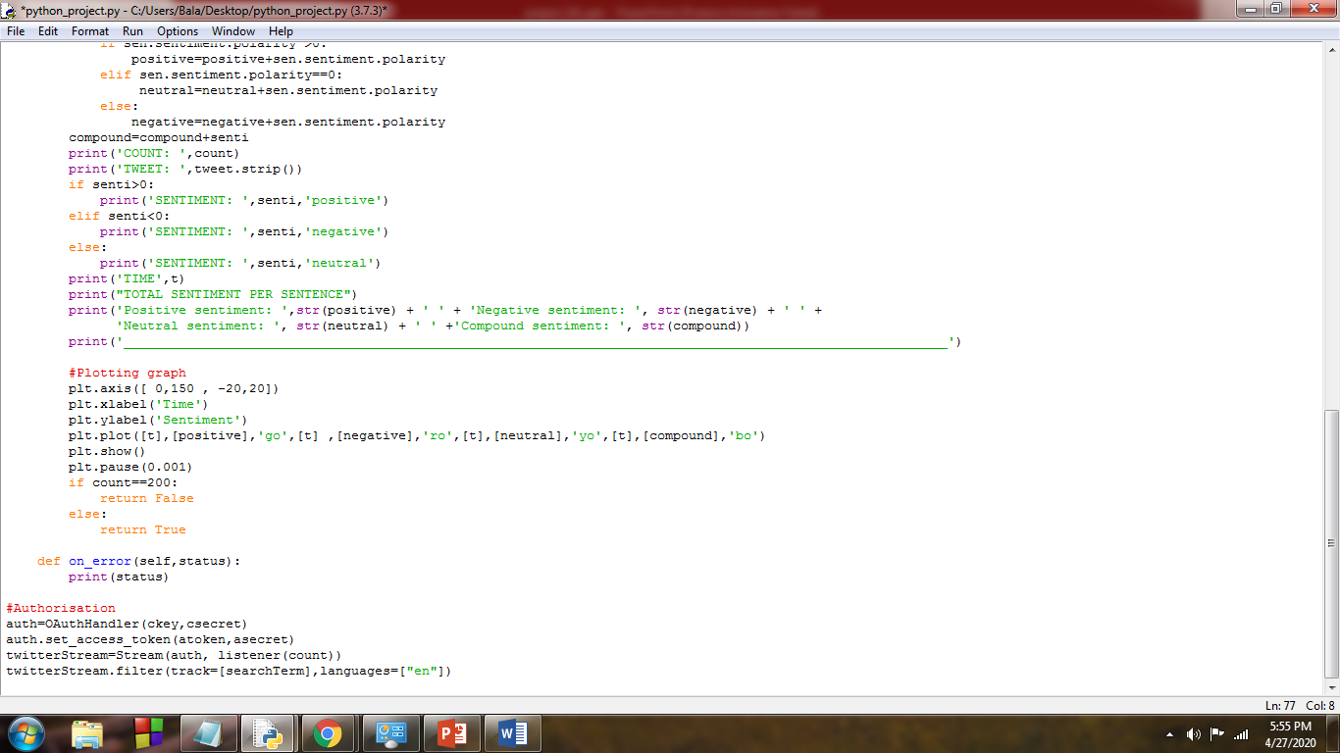

Slide 9
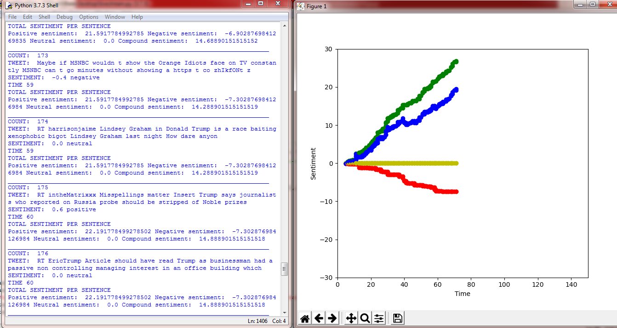
OUPUT

Slide 10
REFERENCES
https://textblob.readthedocs.io/en/dev/quickstart.html
https://matplotlib.org/tutorials/introductory/pyplot.html
http://docs.tweepy.org/en/latest/
http://docs.tweepy.org/en/latest/streaming_how_to.html#step-1-creating-a-streamlistener
https://docs.python.org/3/library/re.html
https://www.analyticsvidhya.com/blog/2018/02/natural-language-processing-for-beginners-using-textblob/

Slide 11
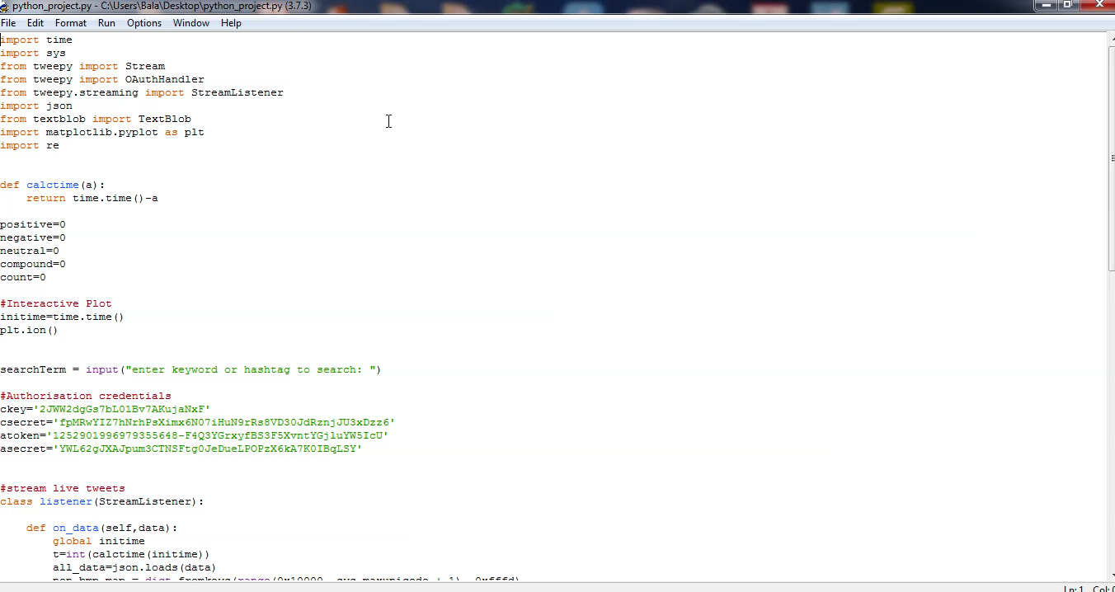
DEMO

Slide 12


MOVIE REVIEW ANALYSIS
Sentiment Analysis can also be performed for Movie Reviews.
If the user enters the list of mixed reviews of a movie, sentiment analysis can performed on the data and the overall Review chart is displayed.
PACKAGES/LIBRARIES USED:
TEXTBLOB
MATPLOTLIB

Slide 13
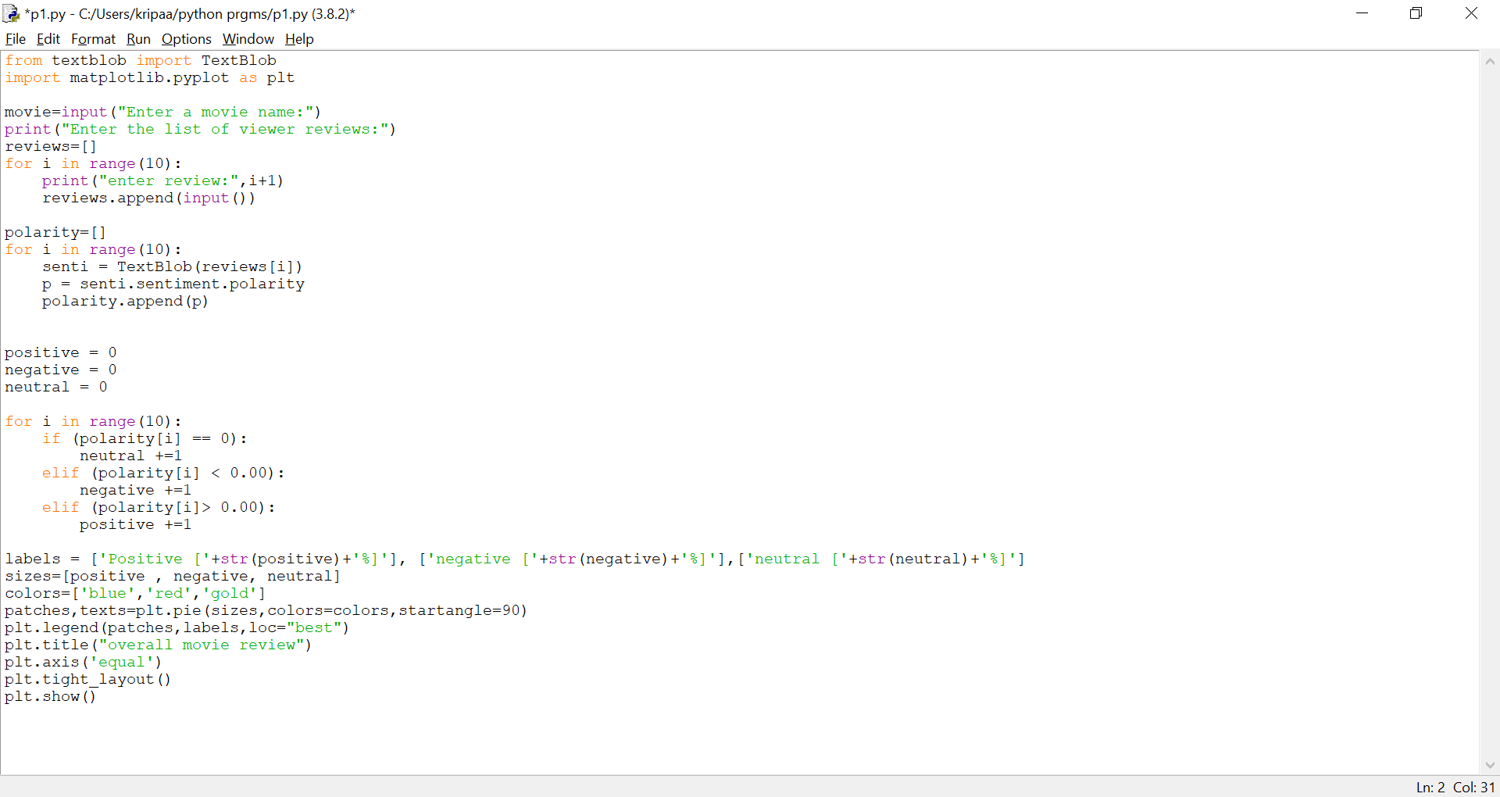
CODE

Slide 14
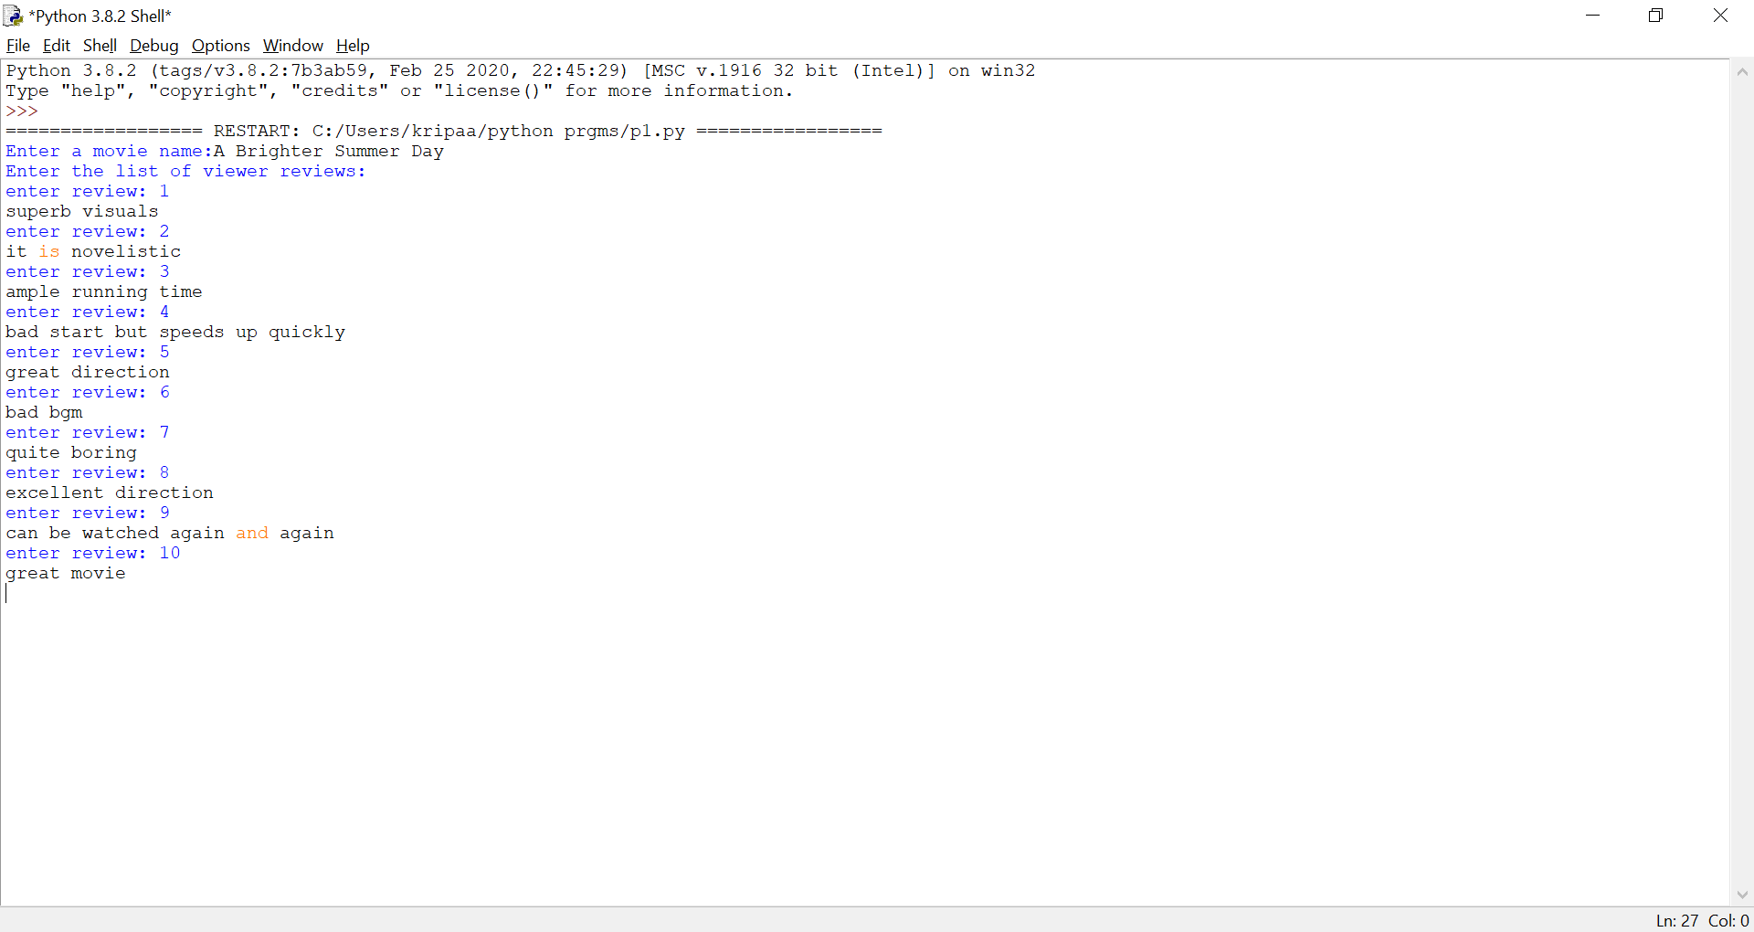
INPUT AND OUTPUT
INPUT
MOVIE NAME and REVIEWS
OUTPUT
REVIEW CHART

Slide 15

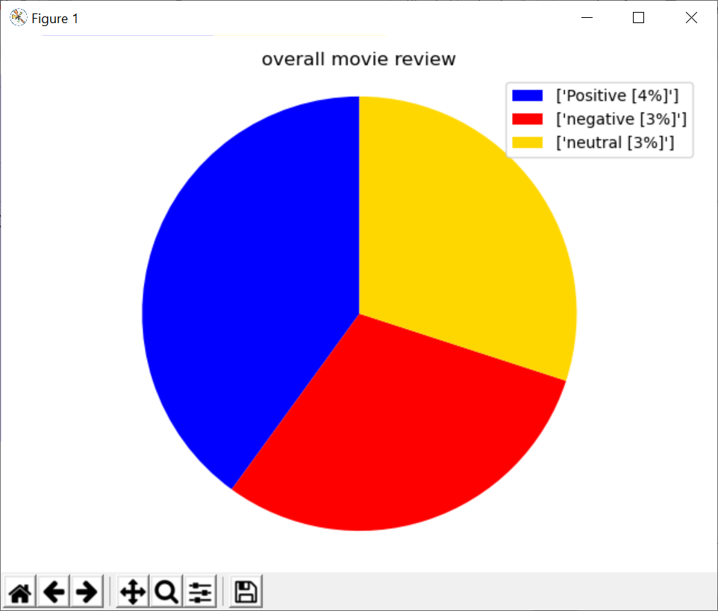

SENTIMENT ANALYSIS CHART

Slide 16
REFERENCES
https://textblob.readthedocs.io/en/dev/
https://www.analyticsvidhya.com/blog/2018/02/natural-language-processing-for-beginners-using-textblob/
https://www.digitalocean.com/community/tutorials/how-to-perform-sentiment-analysis-in-python-3-using-the-natural-language-toolkit-nltk
https://matplotlib.org/
https://matplotlib.org/users/pyplot_tutorial.html

Slide 17
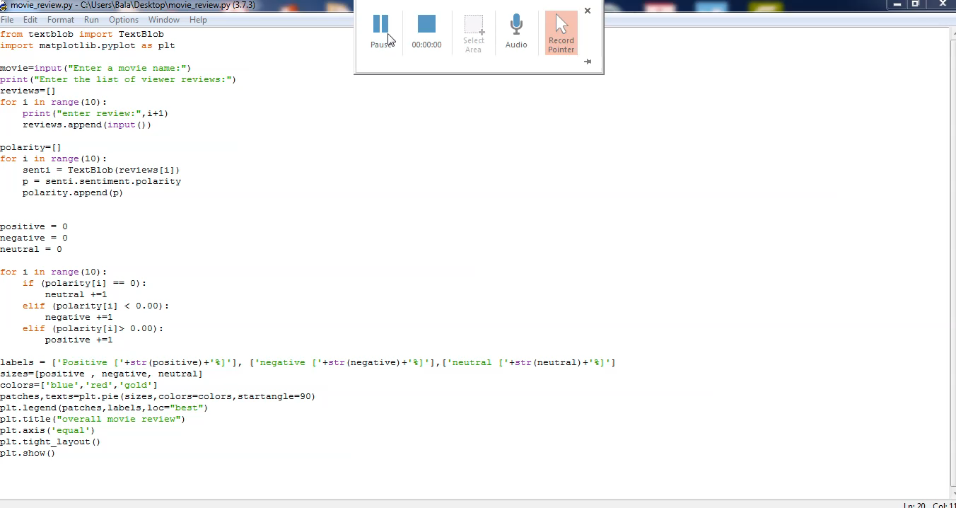
DEMO

Slide 18

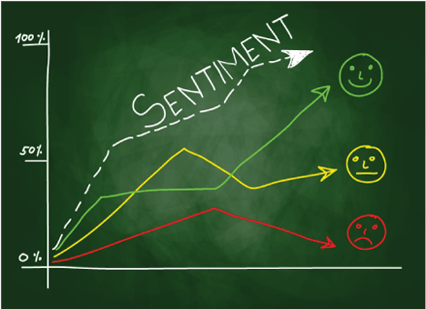
OTHER APPLICATIONS OF SENTIMENT ANALYSIS
The Analysis can also be performed for various other situations like,
Online shopping-product reviews
Restaurant ratings etc.
Sentiment Analysis can also be performed for a given voice using speech recognition in python.

